Slide 1
AI-Driven Course Popularity Analyzer
BHARATHEES K
7376232AG106

Slide 2
INTRODUCTION
In the rapidly evolving landscape of online education, students often struggle to identify which courses offer true value versus those that are simply trending. The AI-Driven Course Popularity Analyzer is designed to bridge this information gap. By leveraging Generative AI and data analytics, this project provides a comprehensive "Intelligence Report" for any given course. Beyond just popularity, the system evaluates technical depth, real-world practical applications, and future career prospects, empowering learners to make data-backed decisions about their professional development.

Slide 3
PROBLEM STATEMENT
In the current digital age, students and professionals face a massive "choice paralysis" due to an overwhelming number of online courses that often lack transparency regarding their actual career value. Most platforms provide superficial ratings but fail to offer deep insights into a course's technical complexity, real-world industry applications, or long-term job market trends, leading many to invest time and money into skills that may be outdated or low-demand. The AI-Driven Course Popularity Analyzer addresses this by serving as a virtual academic advisor, leveraging the Gemini and Hugging Face APIs to transform simple course titles into data-backed intelligence reports. By instantly validating subjects and providing critical insights into salary trends and hiring companies, the platform bridges the gap between raw information and actionable career roadmaps, ensuring that every hour spent learning provides a maximum return on investment.

Slide 4
TECHNOLOGY STACK
AI Engines:
Hugging Face (Inference API)
Frontend:
React.js & Material UI
Backend:
Node.js & Express
Deployment:
Vercel & Render

Slide 5
DATABASE & SECURITY
Storage: mongodb atlas
Flexible data: stores complex AI reports as easy-to-read JSON documents.
Cloud-based: securely hosted on the cloud for 24/7 access.
History: keeps track of user profiles and previous course analyses.
Protection: security layers
Safe login: uses google oauth so users don't need to share passwords.
Digital bouncer (cors): blocks unauthorized websites from accessing the data.
Session security: uses jwt to verify users are actually logged in.
Hidden keys: private api keys are hidden in environment variables.

Slide 6
SYSTEM ARCHITECTURE
React (Frontend)
Node.js + Express (Backend)
Google OAuth 2.0
CORS
Hugging Face API
MongoDB (Database)

Slide 7
ER DIAGRAM
USER ENTITY
_id
name
username
email
google_id
profile_pic
password(hashed)
createdAt
updatedAt
COURSE_REPORT_ENTITY
_id
user_id
coursename
analysisbody
Suggestions
timestamp
createdAt
Generates

Slide 8
Generate Analysis
Dashboard
Profile
WORK FLOW
Student
History Activity
Course Analysis
Course Suggestions
User
Login
Admin
Dashboard
Admin Pannel
Profile
History Acytivity

Slide 9
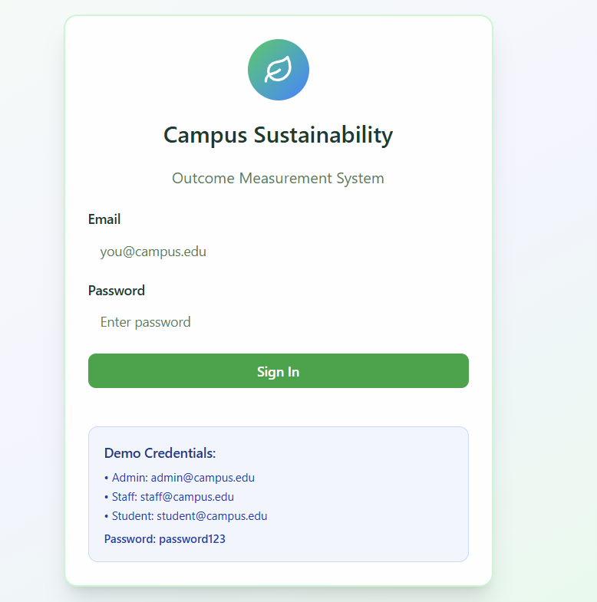
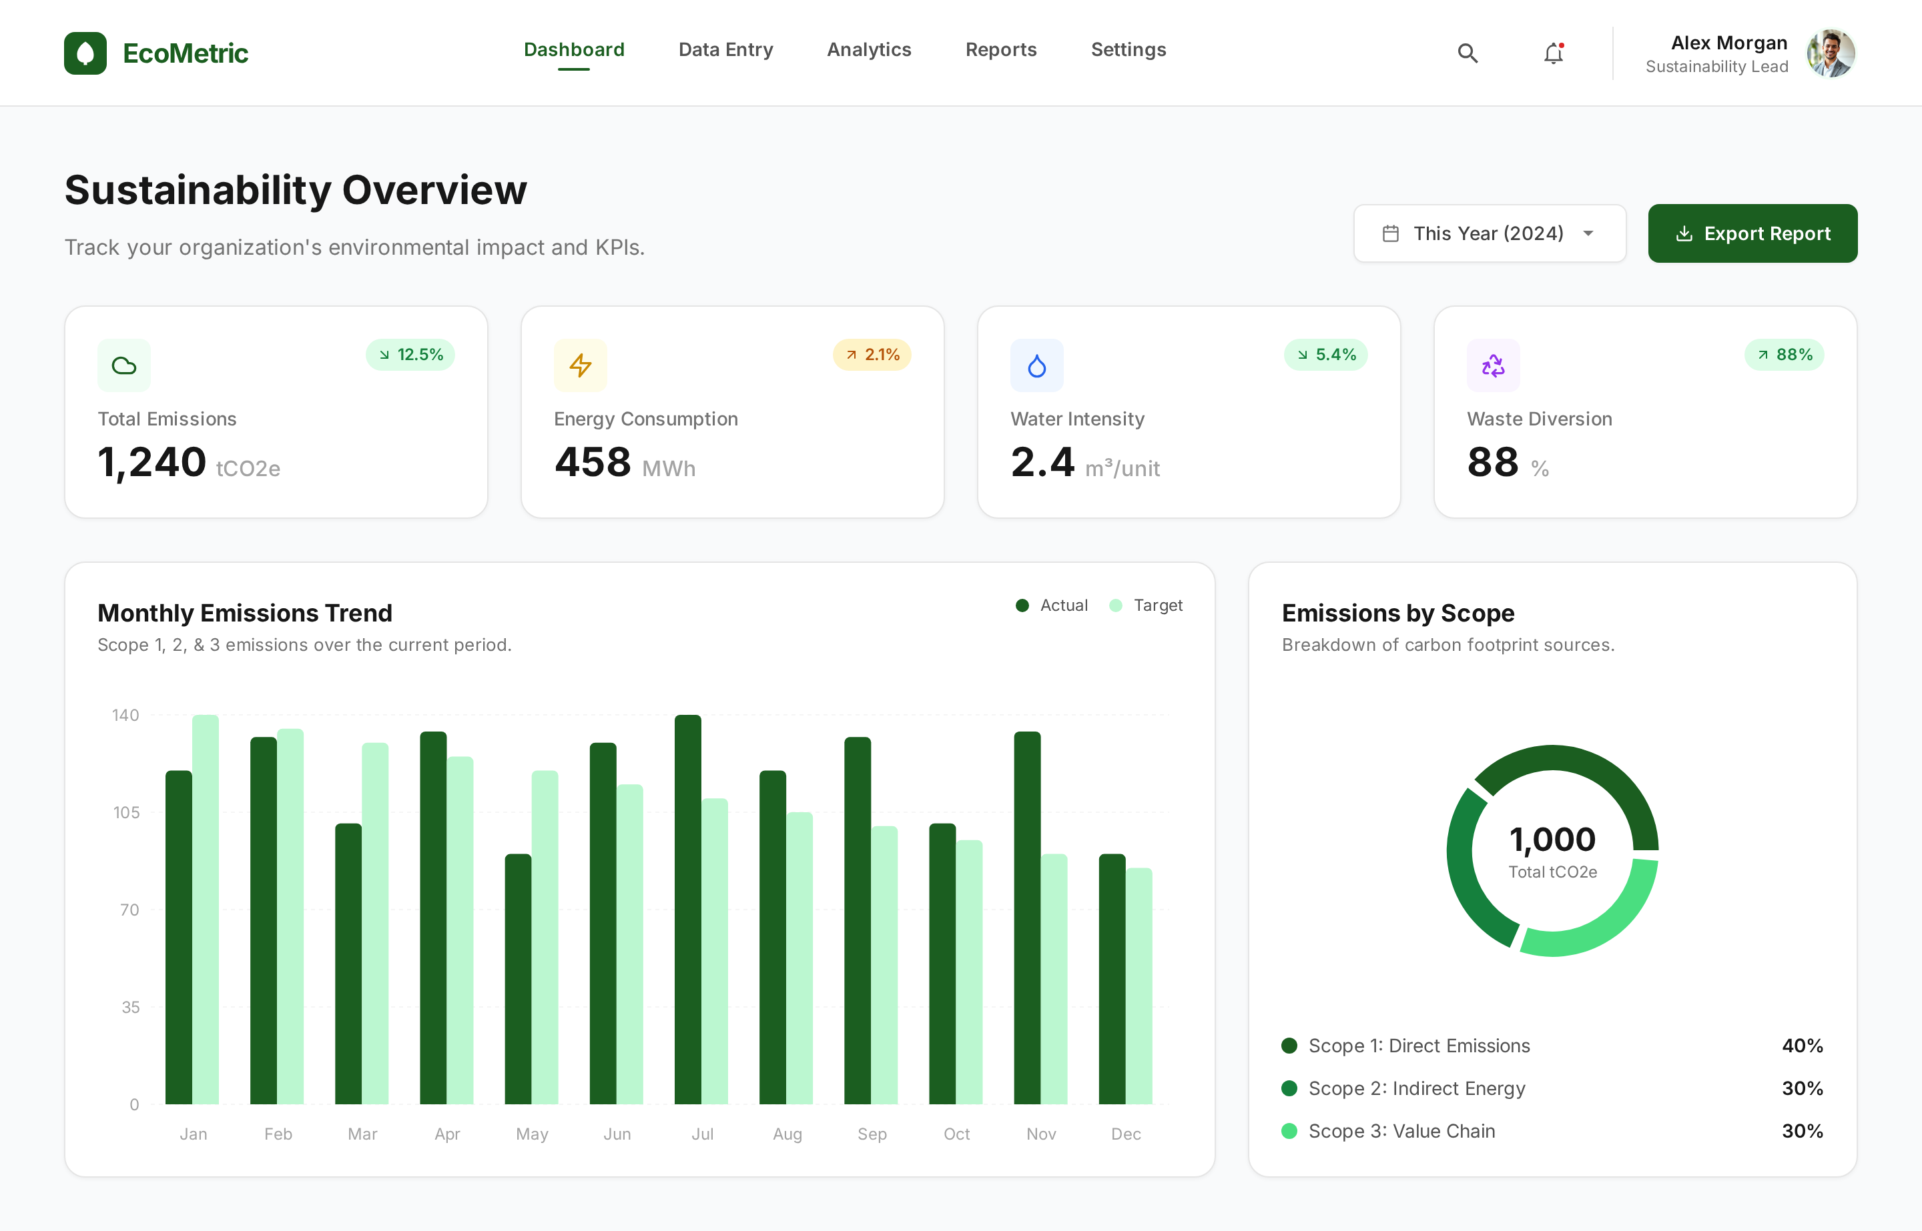
UI/UX Frame WORk

Slide 10



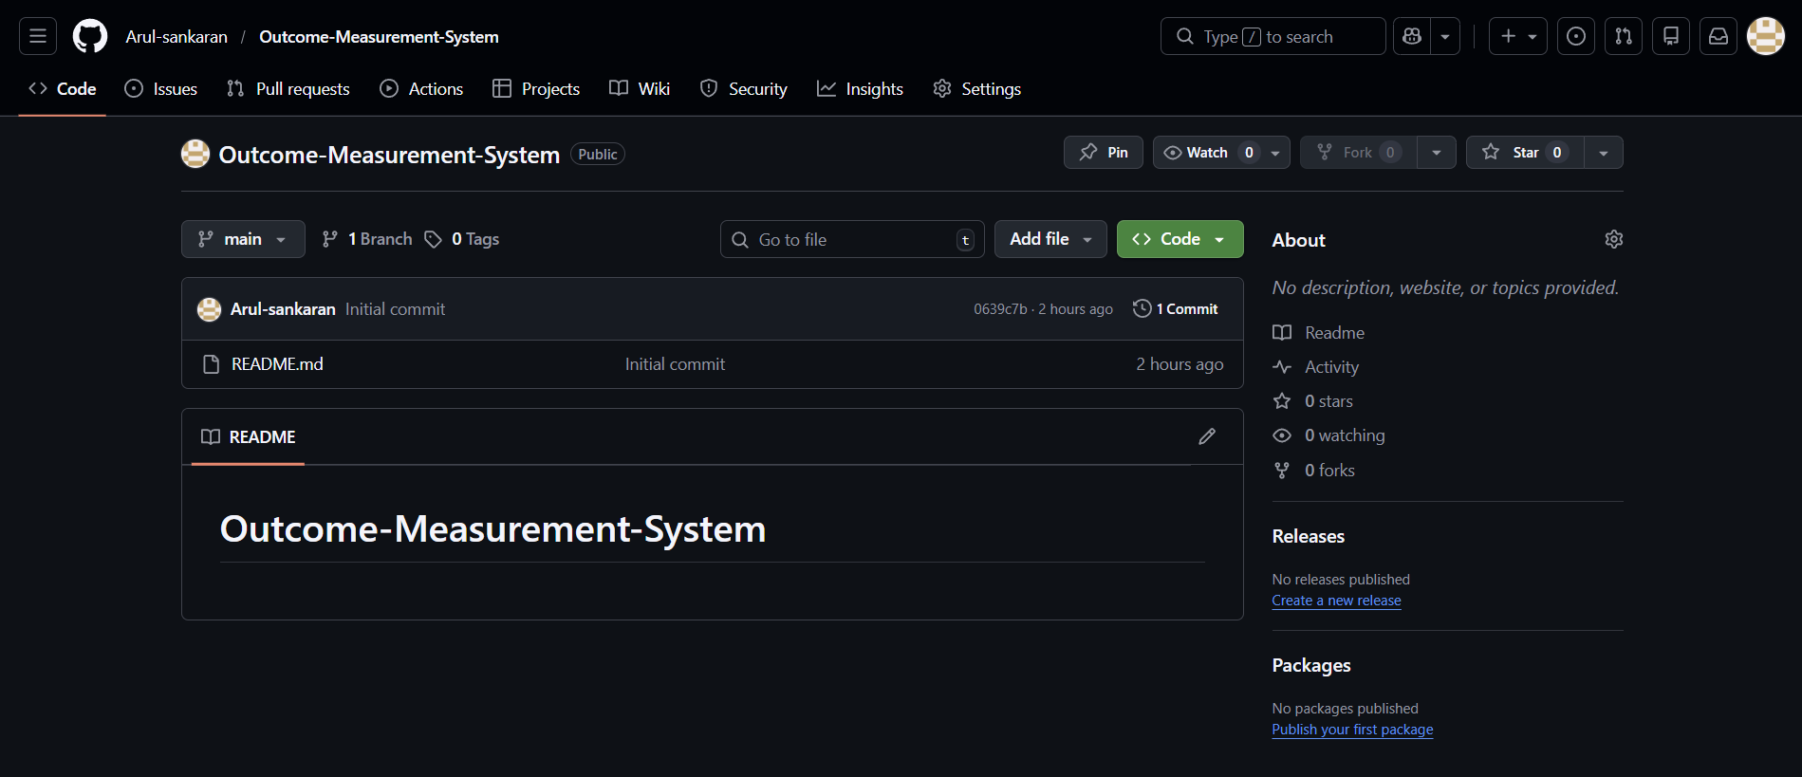
GITHUB

Slide 11
Thankyou

